Slide 1
Vivado Design Flow
Artix-7
Vivado 2015.2 Version

Slide 2
Outline
Vivado IDE Features and Benefits
Vivado Design Suite Introduction
Vivado Design Flow

Slide 3
Who Should Use Vivado?
Designers needing an interactive design approach
Analysis and area constraints to drive place & route
Challenging designs
Large devices, complex constraints, and high device utilization
Advantages are also seen with small devices
Designs experiencing implementation issues
Performance, capacity, run time, and repeatability
Designs requiring implementation control
Users looking for options other than just a pushbutton flow
Visualize design issues from many aspects
Block-based design constraints
Notes:
Typical designers are involved in complex, high-density designs. They do not mind using a more interactive and iterative approach, as opposed to a pushbutton flow (as long as it produces improved timing results). Vivado IDE users also include those who want to be more involved (in control) of what the implementation tools are doing.
The productivity gains enabled by the Vivado IDE will help reduce the overall implementation iterations required by these types of designs.
Typical designers need extra performance and have experienced implementation issues previously.
Often, complex designs require many iterations to finalize the performance. This is because designers run the risk of not meeting their timing with each iteration when running implementation on the entire design. The use of area constraints can improve the consistency of your timing results, although it does not guarantee meeting your timing objectives.

Slide 4
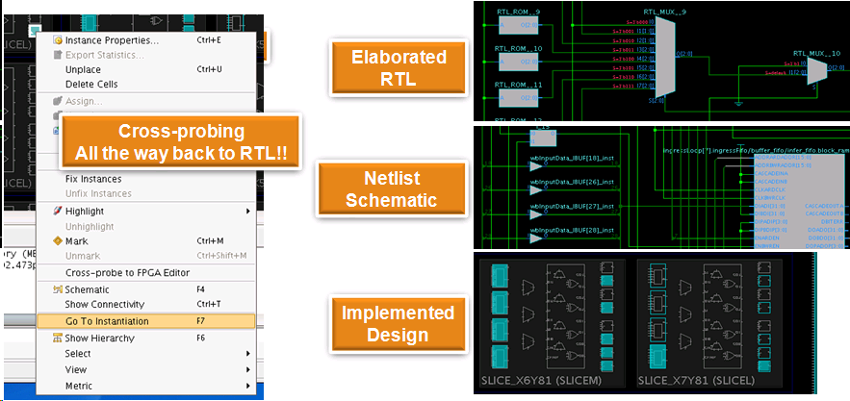
Vivado’s Visualization Feature
Visualize and debug your design at any flow stage
Cross-probing between netlist/schematic/RTL

Slide 5
Outline
Vivado IDE Features and Benefits
Vivado Design Suite Introduction
Vivado Design Flow

Slide 6
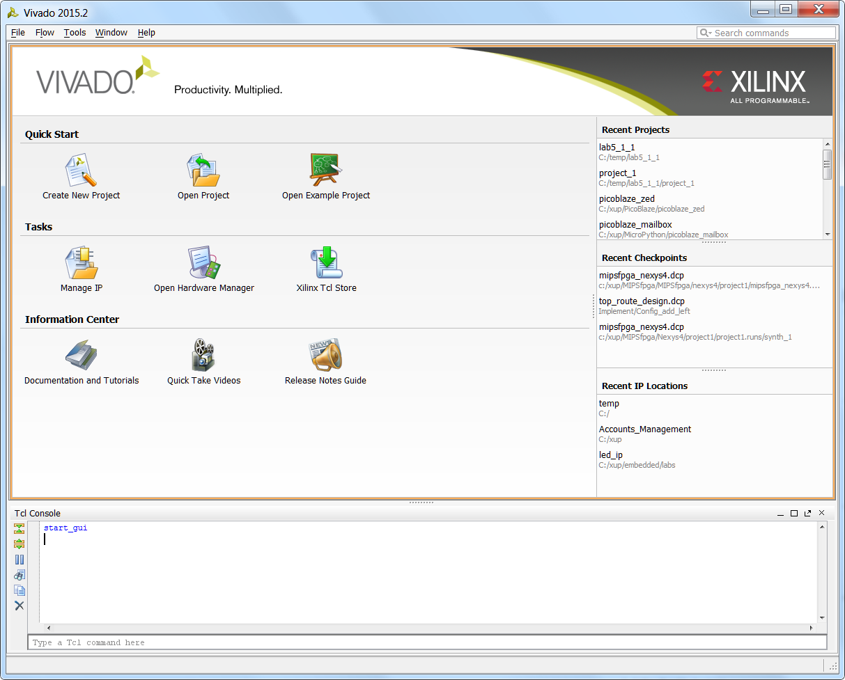
Getting Started Jump Page
All buttons grouped by functionality
Quick Start
Previous projects can quickly opened
Links to create new or example projects
Tasks
IP management, hardware manager, Tcl Store
Helpful links
Documentation and Tutorials
Invokes PDF viewer for documentation
Quick Take Videos
Release Notes Guide
Tcl Console for command line access

Slide 7
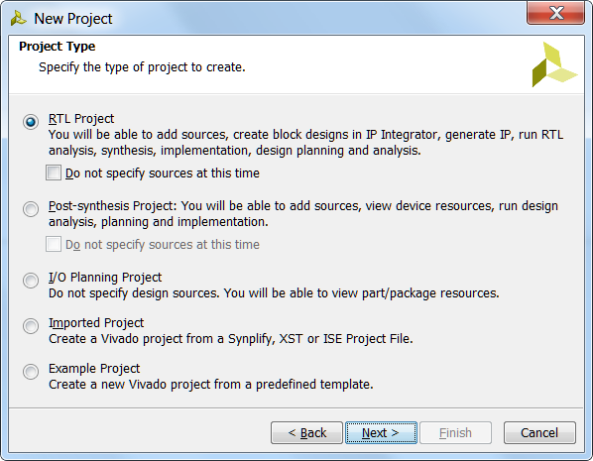
New Project Creation Wizard
Very first step is project creation with five choices
Five different types of projects:
RTL
Front-to-back (even for Block Designs)
Post-synthesis
EDIF or NGC
I/O planning
For early pin testing
No design sources
Import Project
Imports existing project from Synplify, XST, or ISE
Example Project
Notes:
RTL Project:
The RTL Project environment enables analysis of the compiled RTL design including logic exploration, resource and power estimation, DRCs, and I/O pin planning.
Post-synthesis Project:
This is where pre-implementation design analysis, debug core insertion, and constraint definition is performed. You can explore various constraints sets, devices, and implementation options.
Import ISE tool results:
The Implemented Design environment loads the netlist and implementation results directly from the run directory to ensure that the viewed data represents the launched run.

Slide 8
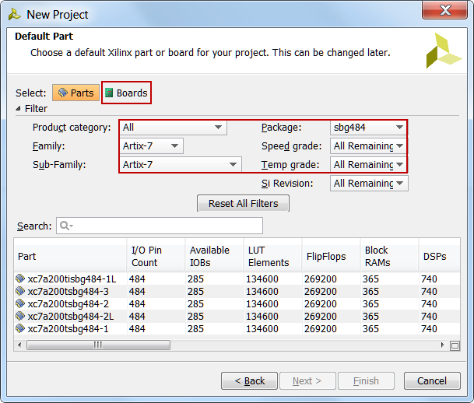
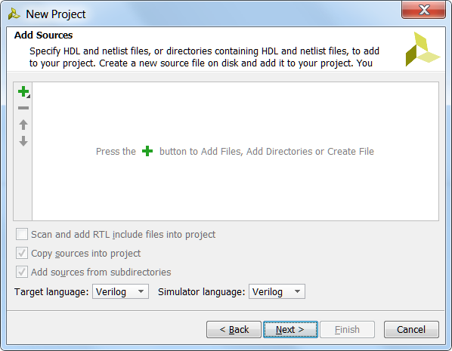
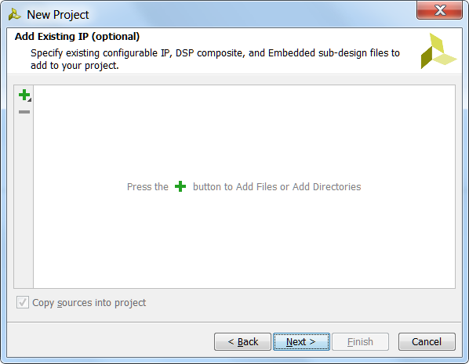
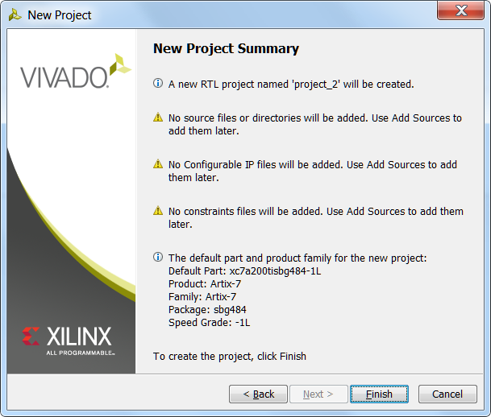
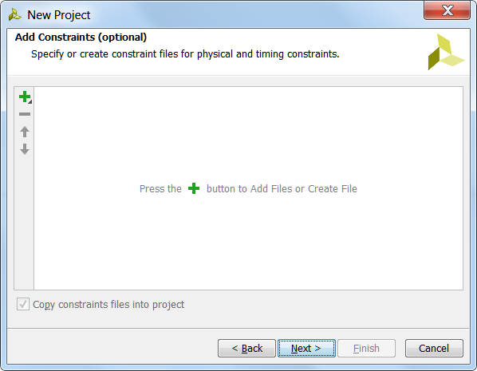
Project creation flow (RTL/Synthesized Design)
Defines the project name and location
Select source files in RTL project creation
All recognized source files, Verilog, VHDL, in the directory and subdirectories, can be added
Select post-synthesized netlist in Post-synthesized project creation
All synthesized files in the directory and subdirectories, are added
Select constraint files
One or more constraints files including IP specific and top-level can be added
Select target device or pre-defined board
Reference original existing files or import and copy them into the project

Slide 9
Project Data
All project data is stored in a project_name directory containing the following basic set of directories:
project_name.xpr file: Vivado project file, contains project settings
project_name.runs directory: Contains all run data
project_name.srcs directory: Contains all imported local HDL source files, netlists, and XDC files
project_name.data directory: Stores floorplan and netlist data

Slide 10
Journal and Log Files
Journal file (vivado.jou)
Contains just the Tcl commands executed by the Vivado IDE
Log file (vivado.log)
Contains all messages produced by the Vivado IDE, including Tcl commands and results, info/warning/error messages, etc.
Location
Linux: directory where the Vivado IDE is invoked
Windows via icon: %APPDATA%\Xilinx\Vivado or C:\Users\<user_name>\AppData\Roaming\Xilinx\Vivado
Windows via command line: directory where the Vivado IDE is invoked
From the GUI
Select File > Open Log File
Select File > Open Journal File

Slide 11
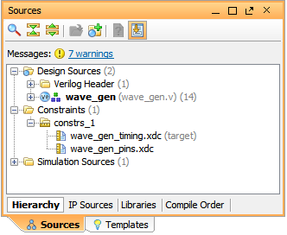
Constraints File Management
Constraint sets are a collection of XDC files
A project can contain multiple constraint sets
For a constraints set to be applied, it must be set to "active"
Any constraint set can be made active by right-clicking and selecting Make Active
Target XDC
The XDC file in a constraint set to which new constraints are written
From the Constraints Wizard for example
Target XDC can be specified by right-clicking and selecting Set As Target Constraint File

Slide 12
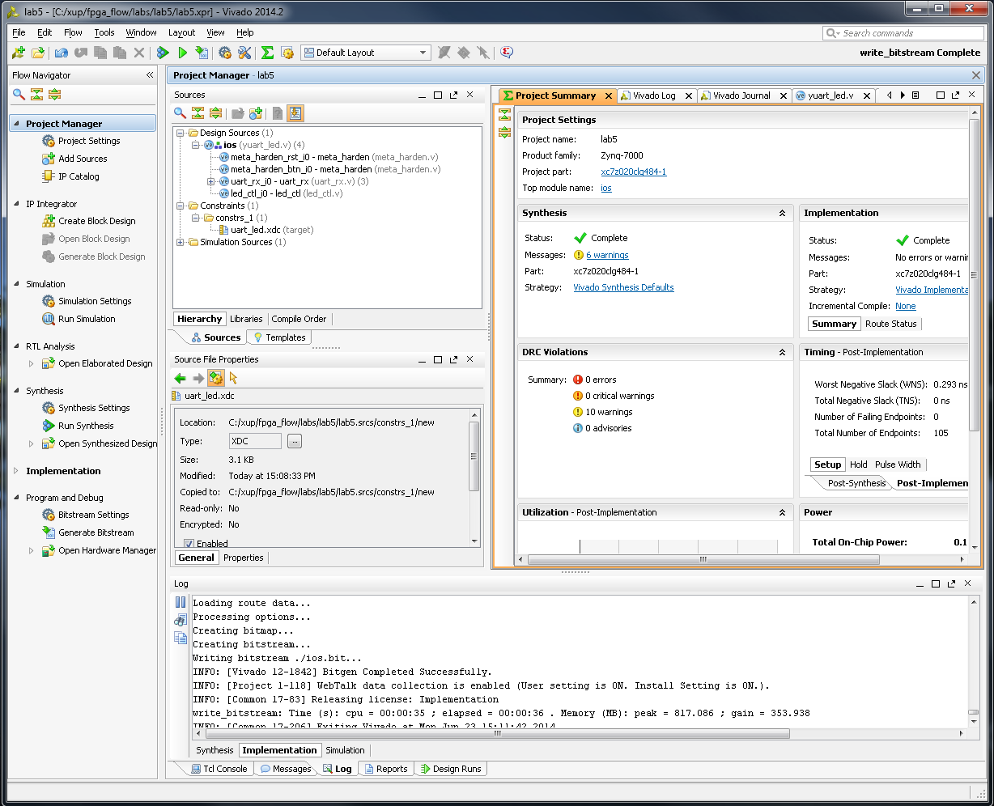
Project Navigator
Used to manage sources, customize IP, and view project details in the Project Summary
Flow Navigator
Sources view
Hierarchical display of sources, including constraints files
IP Sources and Libraries view
HDL and netlists including references to library and location
Project Summary
Gives access to device utilization (resources), timing summary, and strategy information
Tcl Console, Messages, Compilation, Reports, and Design Runs

Slide 13
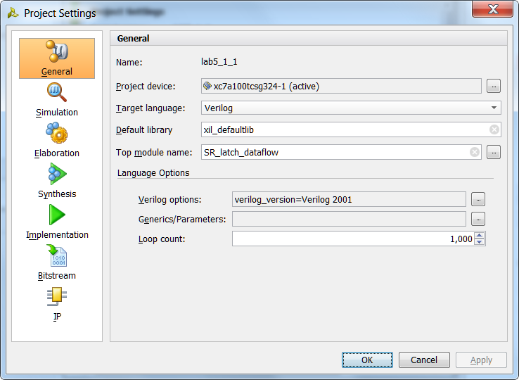
Project Settings
General settings
Select device
Target HDL language
Simulation tool (Vivado simulator included)
Top module name
Language options
Other settings are covered in their respective modules

Slide 14
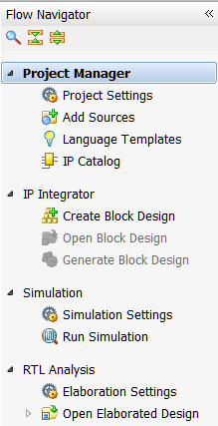
Flow Navigator – RTL Project
Configure project sources
Add HDL source files, constraints files, simulation files, block designs
IP Integrator
Create, open, generate a block design
Run Simulation
XSIM simulator included
Behavioral, post-synthesis, post-implementation
RTL Analysis
Open Elaborated Design button: Loads the elaborated RTL design

Slide 15
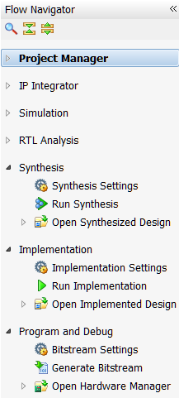
Flow Navigator – RTL Project, cont’d…
Run Synthesis
Timing driven
Open Synthesized Design button: Loads synthesized netlist
Run Implement button: Runs implementation tools
link, opt, power_opt, place, phys_opt, and route
Open Implemented Design button: Loads implemented design
Program and Debug: Launches programming and debugging tools
Open Hardware Manager to program the FPGA
Hardware Manager also contains debug capabilities

Slide 16
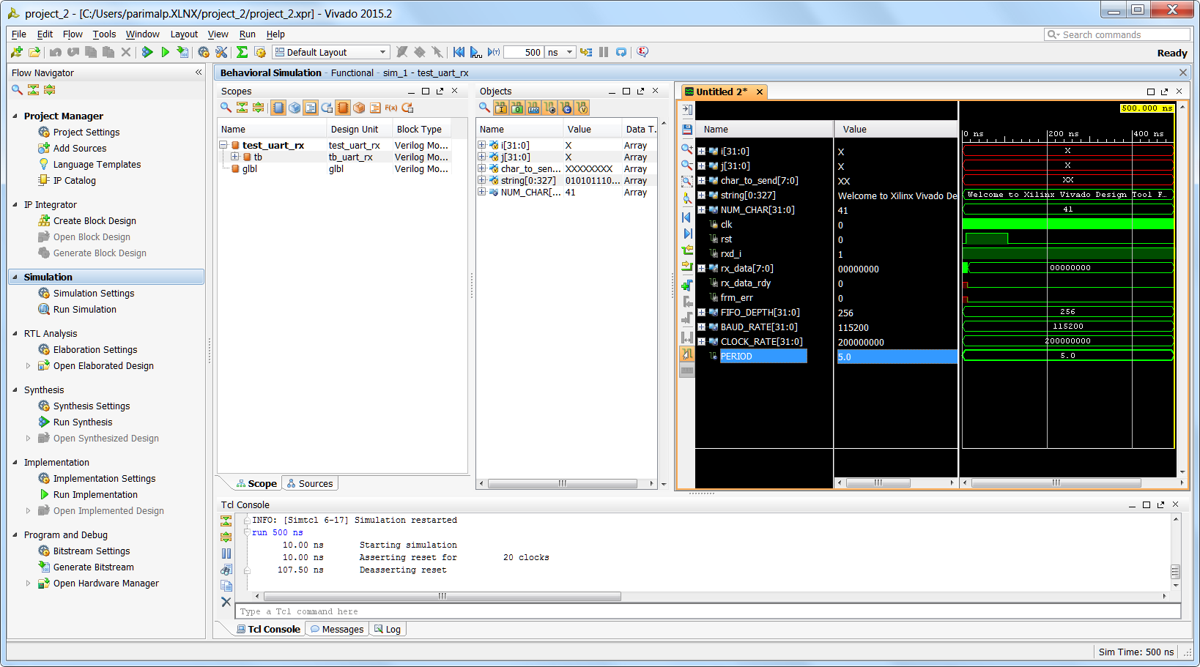
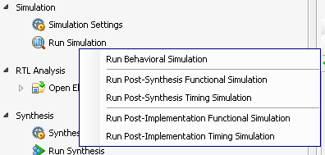
Simulation
The Vivado simulator, XSIM, supports RTL, netlist, and timing simulation
Part of the Vivado installation

Slide 17
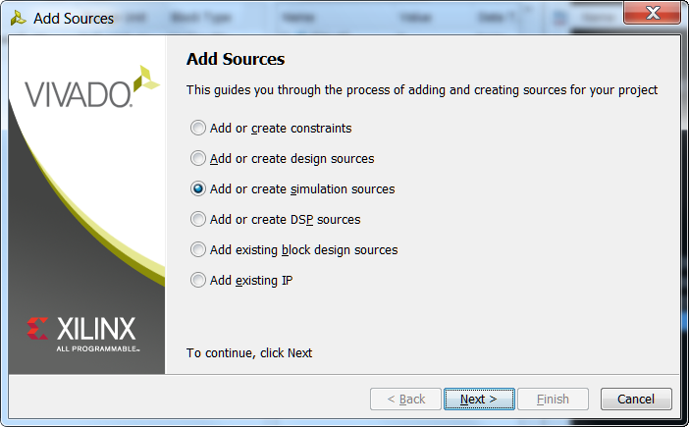
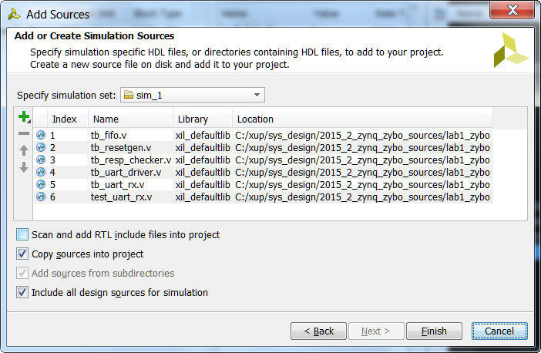
Adding Testbench Files
Testbench sources (*.V or *.VHD) must be added separately from design sources
In the Flow Navigator, click Add Sources
Select Add or Create Simulation Sources option and click Next
Click on the Green + button, add files…, add directories… if the testbench file is already available or click on Create File… button to create a new testbench file
Select a file type- Verilog, Verilog Header, SystemVerilog, or VHDL
Browse to an existing testbench or enter a filename to create

Slide 18
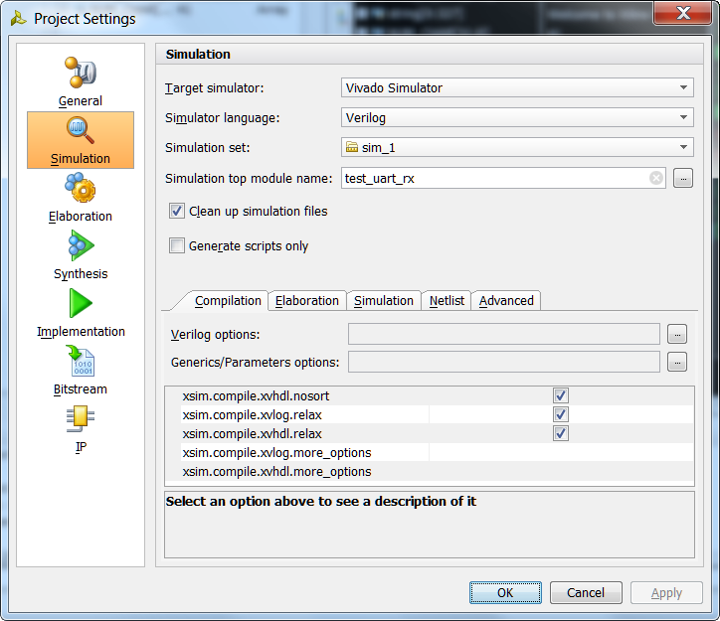
Simulation Settings
Allows selection of compilation and simulation properties
From the Flow Navigator, click Simulation Settings
The simulation top module is the testbench you have written and specify
Additional options can be entered
More Compilation Options field under Compilation tab
More Simulation Options field under Simulation tab
Refer to the Vivado Design Suite Simulation Guide (UG900) for more information

Slide 19
Simulation Results
Graphical waveform display
Toolbar buttons for adding markers, measuring delays, and zooming
Buses can be expanded to view individual signals
Dividers can be inserted to visually isolate groups of related signals
Console displays any messages output from testbench
By default, the top-level signals are displayed

Slide 20
Outline
Vivado IDE Features and Benefits
Vivado Design Suite Introduction
Vivado Design Flow

Slide 21
Xilinx Design Flow
Plan & Budget
Create Code/
Schematic
HDL RTL
Simulation
Implement
Functional
Simulation
Synthesize
to create netlist
Translate
Map
Place & Route
Attain Timing
Closure
Timing
Simulation
Generate BIT File
Configure FPGA

Slide 22
Design Entry
Create designs in HDL or Schematic
Plan and budget：原理图
Create code: 生成.v文件

Slide 23
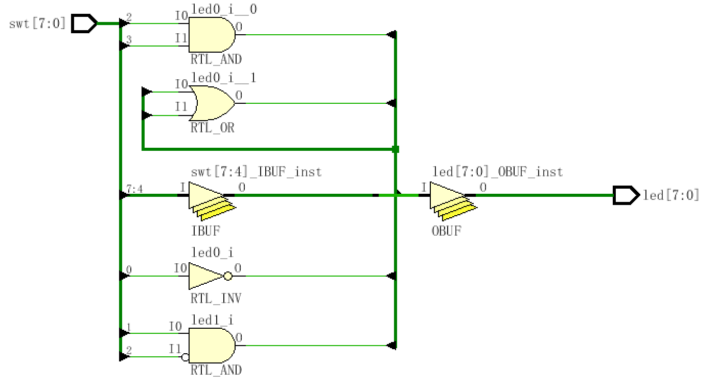
RTL 分析
寄存器传输级（RTL，Register Transfer Level）：指不关注寄存器和组合逻辑的细节，通过描述寄存器到寄存器之间的逻辑功能描述电路的HDL层次。
Notes:
其他仿真。是指提取有关的器件延迟、连线延时等时序参数，并在此基础上进行的仿真，它是非常接近真实器件运行情况的仿真。

Slide 24
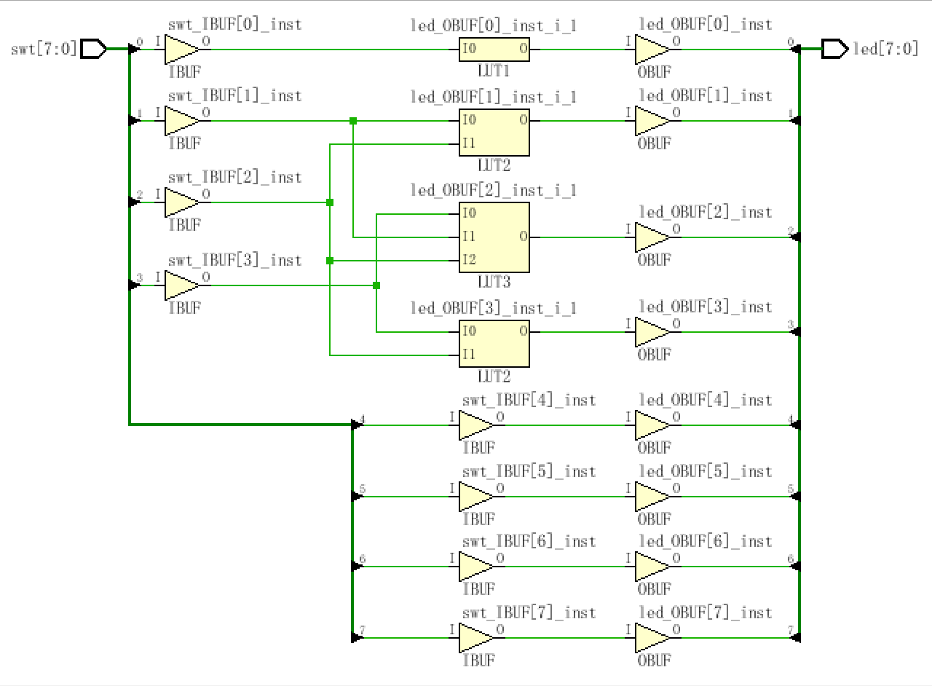
Synthesis
Generate a netlist file
After coding up your HDL code, you will need a tool to generate a netlist (NGC or EDIF)
所谓综合(Synthesize) 是指将xxx.v文件输入翻译成由与、或、非门等基本逻辑单元组成的门级连接，并根据设计目标和要求优化所生成的逻辑连接，编译生成门级网表文件Netlist文件，表示自动生成的门级逻辑结构网表。
Notes:
其他仿真。是指提取有关的器件延迟、连线延时等时序参数，并在此基础上进行的仿真，它是非常接近真实器件运行情况的仿真。

Slide 25
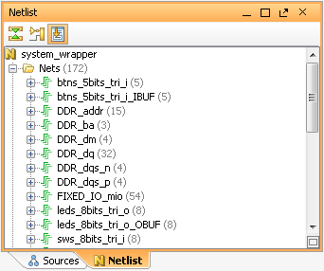
What is a Netlist?
A Netlist is a description of your design
Consists of cells, pins, port and nets
Cells are design objects
Instances of user modules/entities
Instances of library Basic Elements (BELs)
LUTs, FF, RAMs, DSP cells, etc…
Generic technology representations of hardware functions
Black boxes
Pins are connection points on cells
Ports are the top level ports of your design
Nets make connections between pins and from pins to ports

Slide 26
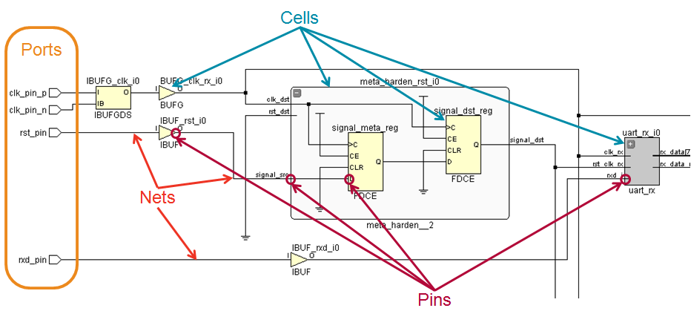
Netlist Objects
Notes:
Ports are the primary inputs and outputs of the current design (normally the top level module).
Pins are the connections to instances – both instantiations of hierarchical objects and primitive cells.

Slide 27
Functional Simulation
行为级仿真（behavioral simulation）：是指仅对逻辑功能进行测试模拟，以了解其实现的功能是否满足原设计的要求，行为仿真过程没有加入时序信息，不涉及具体器件的硬件特性，如延时特性。
其他仿真：是指提取有关的器件延迟、连线延时等时序参数，并在此基础上进行的仿真，它是非常接近真实器件运行情况的仿真。
Notes:
其他仿真。

Slide 28
Implementation
Process a netlist file
Consists of three phases
Translate: Merge multiple design files into a single netlist
Map: Group logical symbols from the netlist (gates) into physical components (slices and IOBs)
Place & Route: Place components onto the chip, connect the components, and extract timing data into reports
注：实现主要根据不同的FPGA来具体的细化之前综合得到的网表。比如说工具可以具体的算出某个信号的延迟是多少。其中包括多少的走线延迟和多少的组合逻辑延迟。然后最后根据FPGA的内部结构决定把这个门放到哪里。
Netlist Generated From Synthesis
.
.
.
Implement
Translate
. . .
Map
Place & Route
.
.
.

Slide 29
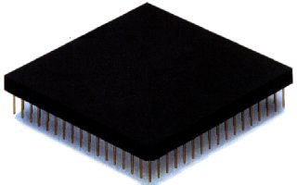
Configuration
Testing and Verification
Once a design is implemented, you must create a file that the FPGA can understand
This file is called a bitstream: a BIT file (.bit extension)
The BIT file can be downloaded
Directly into the FPGA
Use a download cable such as Platform USB
To external memory device such as a Xilinx Platform Flash PROM
Must first be converted into a PROM file

